Slide 1
COMP 301 Analysis of Algorithms
Quick Sort

Slide 2

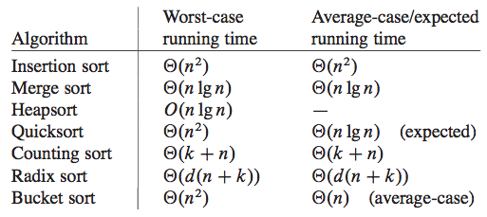
Sorting Problem

Slide 3
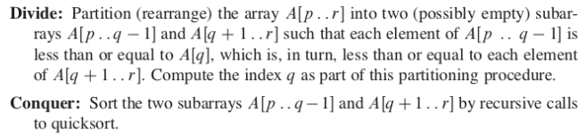
Quick Sort Description
Divide and conquer paradigm

Slide 4
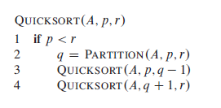
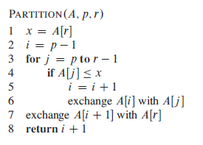
Quick Sort

Slide 5
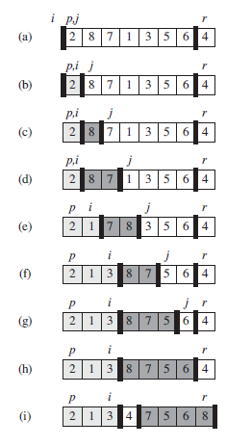
Quick Sort

Slide 6
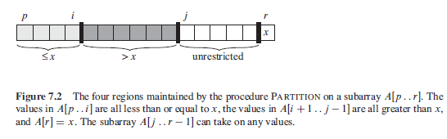
Quick Sort

Slide 7
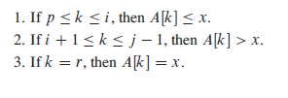
Loop Invariant for Partition
x = A[r] is the pivot element
At the beginning of each iteration of the loop of lines 3–6, for any array index k

Slide 8
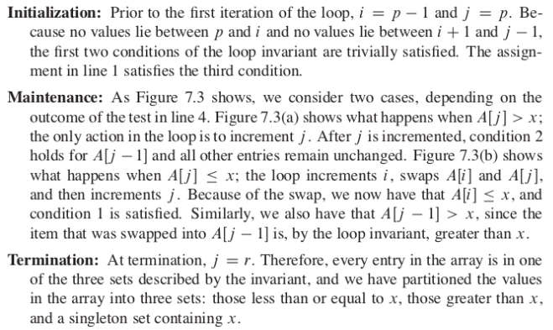
Loop Invariant for Partition

Slide 9
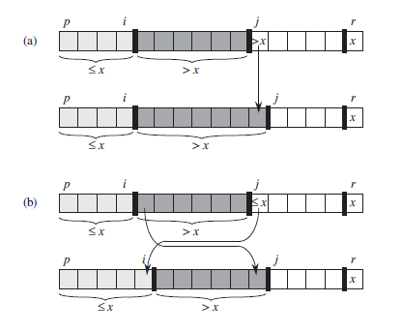
Loop Invariant for Partition

Slide 10

Performance of Quicksort
Depends on whether the partitioning is balanced or unbalanced
Worst-case partitioning
when the partitioning routine produces one subproblem with n-1 elements and one with 0 elements (unbalanced case)
If this unbalanced partitioning happens in each recursive call
Can show by substitution method that

Slide 11

Performance of Quicksort
Best-case partitioning
PARTITION produces two subproblems, each of size no more than n/2, since one is of size floor(n/2) and one of size ceil(n/2) (well-balanced case)
If this well-balanced partitioning happens in each recursive call
Can show by master theorem method that

Slide 12
Performance of Quicksort
Balanced partitioning
PARTITION produces two subproblems, each of size no more than a fraction of n (e.g n/b), since one is of size floor(n/b) and one of size ceil(n-n/b) (balanced case)
If this balanced partitioning happens in each recursive call
Can show by recursion tree that

Slide 13
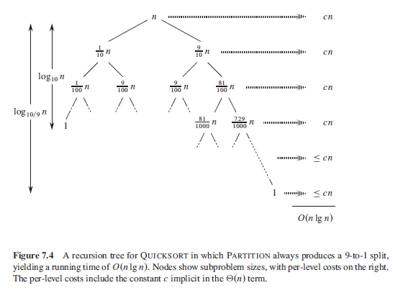

Example for Balanced Partitioning

Slide 14
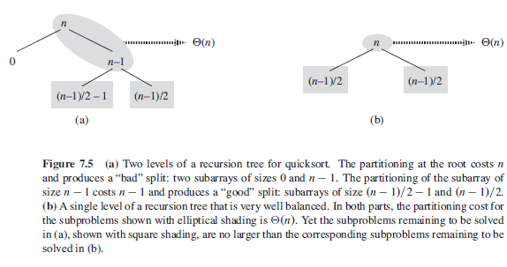
Intuition for Average Case

Slide 15

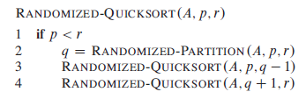
Randomized Version of Quicksort

Slide 16



Worst-case Analysis of Quicksort
Let T(n) be the worst-case time for the procedure QUICKSORT on an input of size n
Use substitution method and first show that T(n) is

Slide 17
Expected Running Time of Quicksort
First will show that it is O(nlogn) and combine with the best case running time of theta(nlogn)
Will concentrate on RANDOMIZED-QUICKSORT
Pivot elements are selected randomly from the subarray passed to RANDOMIZED-PARTITION

Slide 18
Expected Running Time of Quicksort
The running time of QUICKSORT is dominated by the time spent in the PARTITION procedure
Each time the PARTITION procedure is called, it selects a pivot element, and this element is never included in any future recursive calls to QUICKSORT and PARTITION
There can be at most n calls to PARTITION over the entire execution of the quicksort algorithm

Slide 19
Expected Running Time of Quicksort
One call to PA R T I T I O N takes O(1) time plus an amount of time that is proportional to the number of iterations of the for loop in lines 3–6
Each iteration of this for loop performs a comparison in line 4, comparing the pivot element to another element of the array A
If we can count the total number of times that line 4 is executed, we can bound the total time spent in the for loop during the entire execution of QUICKSORT

Slide 20


Expected Running Time of Quicksort

Slide 21
Expected Running Time of Quicksort
Our goal is to compute X, the total number of comparisons performed in all calls to PARTITION
We will not attempt to analyze how many comparisons are made in each call to PARTITION
Rather, we will derive an overall bound on the total number of comparisons

Slide 22
Expected Running Time of Quicksort
Rename the elements of the array A (in sorted order) as
The set of elements between z_{i} and z_{j}
When does algorithm compare z_{i} and z_{j}?
Each pair of elements is compared at most once
Elements are compared only to the pivot element and after a particular call of PARTITION finishes, the pivot element used in that call is never again compared to any other elements

Slide 23



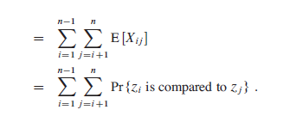
Expected Running Time of Quicksort

Slide 24
Expected Running Time of Quicksort
Once a pivot x is chosen with z_{i} < x < z_{j}, z_{i} and z_{j} cannot be compared at any subsequent time
If z_{i} is chosen as a pivot before any other item in Z_{ij}, z_{i} will be compared with all elements in Z_{ij} except for itself (same for z_{j})
z_{i} and z_{j} are compared if and only if the first element to be chosen as a pivot from Z_{ij} is z_{i} or z_{j}
Prior to the point at which an element from Z_{ij} has been chosen as a pivot the whole set Z_{ij} is together in the same partition
Any element of Z_{ij} is equally likely to be the first one chosen as a pivot
The probability that any given element is the first one chosen as a pivot is 1/(j-i+1)

Slide 25
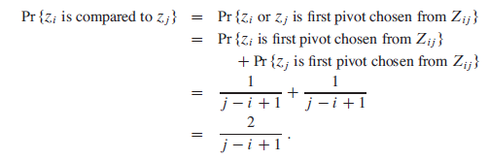
Expected Running Time of Quicksort

Slide 26

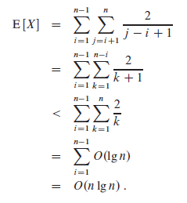
Expected Running Time of Quicksort

